Slide 1

Mental Health Perception: Tech Industry
Team Members:
Harkar Singh Talwar, Manisha Vyas, Neha Palsokar, Sayali Chakradeo, Shreya Sabharwal

Slide 2
Agenda
Sr. No | Topic
1 | Significance
2 | Dataset Overview
3 | Preliminary Analysis
4 | Exploratory Data Analysis
5 | Multinomial Logistic Regression Model
6 | Random Forest
7 | Recommendations
8 | Limitations
9 | Future Scope
10 | References

Slide 3




Significance
1 in 5 adults in the US are living with mental health illness (US Department of Health and Human Services) [1]
51% of people take work from home in the evening and 29% of people work at weekends[5]
84% work through lunch hours and 33% work a 50+ hours a week[5]
Only 11% of employees discuss a recent mental health problem with their line managers.[4]
It is estimated that 1 in 6 people have experienced a common mental health problem[4]
Projects and Initiatives by various Agencies [3]

Slide 4
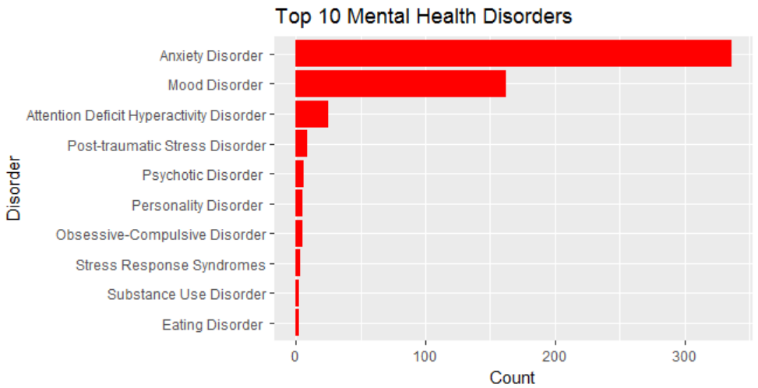
OSMI Mental Health in Tech Survey
Open sourcing Mental illness Survey targeted towards measuring the mental health perceptions in the tech industry. 1433 responses and 63 questions with online voluntary participation.

Slide 5




Data Cleaning
Cleaning the ‘gender’ Feature:
Defined four values for gender variables and assigned each response to one of these appropriately.
Updating Column Headers:
The longer variables (in the form of questions) were renamed to smaller – convenient keywords.
Cleaning ‘Age’ Feature
Removed unrealistic age values which consisted of less than 0.02% of the data. Age range considered: 17 to 74
Cleaning Disorder columns:
Segregated values multiple values selected in the disorder’s column to identify different types of mental health disorders.

Slide 6
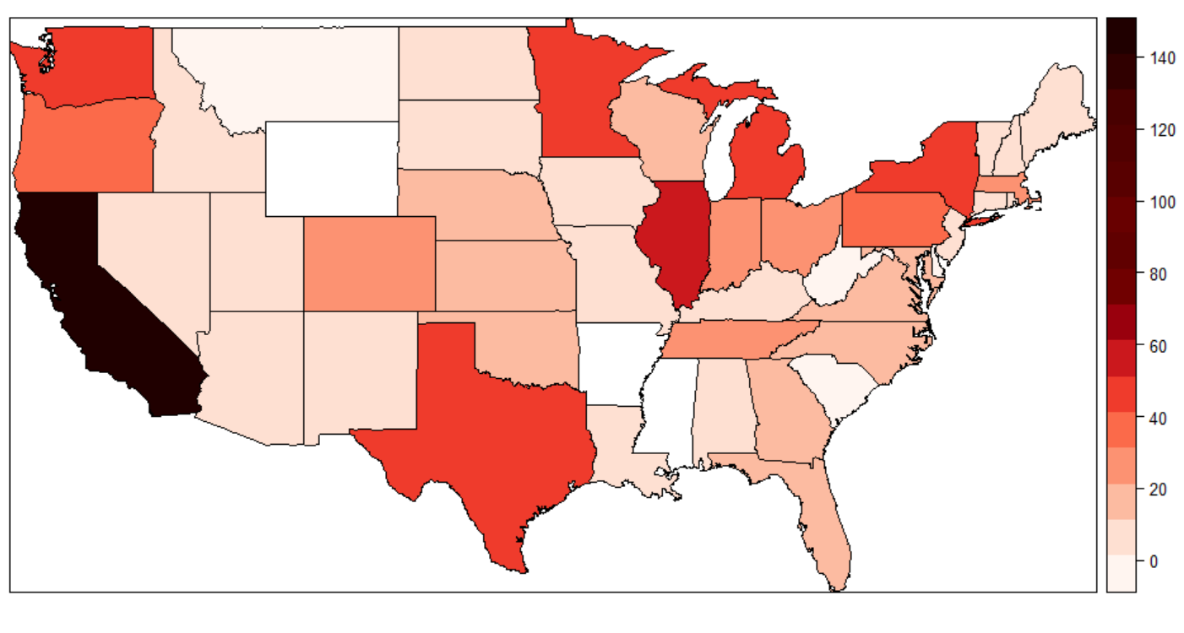
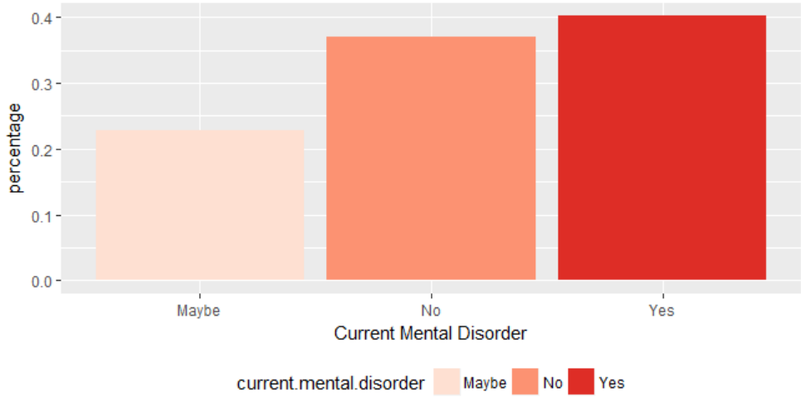
Preliminary Analysis (1 of 2)
The highest number of respondents in the US were from California due to the location of the world’s largest tech corporations in the Silicon Valley
40% of the respondents are currently experiencing mental health issues

Slide 7
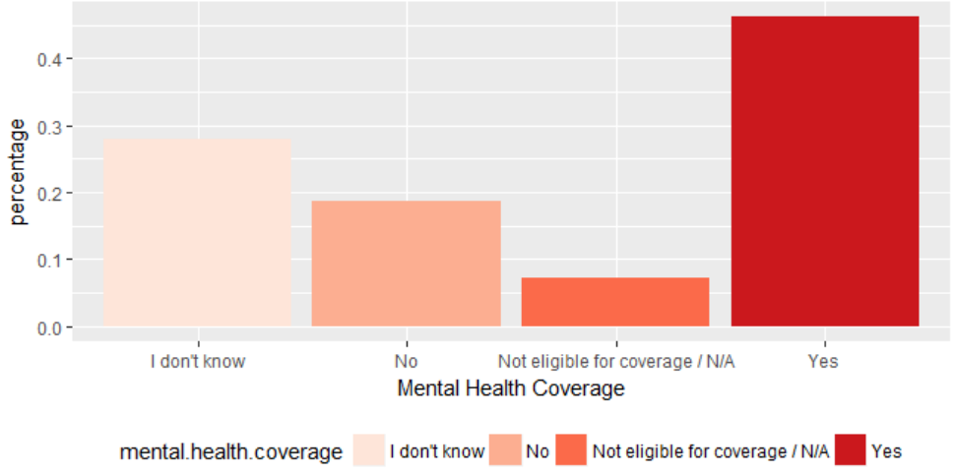
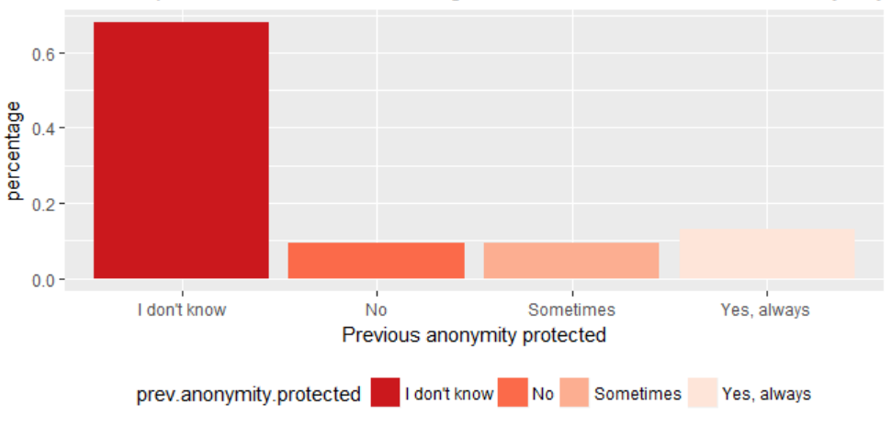
Preliminary Analysis (2 of 2)
46% of respondents are aware about mental health benefits provided by the employer
69% of respondents are unsure about discussing mental health issues if their anonymity was not protected at previous workplace

Slide 8
Exploratory Data Analysis
Assess comfort level of employees for discussing mental health issues with their employers
Effect of age groups for mental health discussion with employers
Employees reaching out for help, given that benefits coverage is provided to them
Impact of Organization size on comfort level in discussion of mental health issues
Mental health discussion and anonymity protection correlation

Slide 9
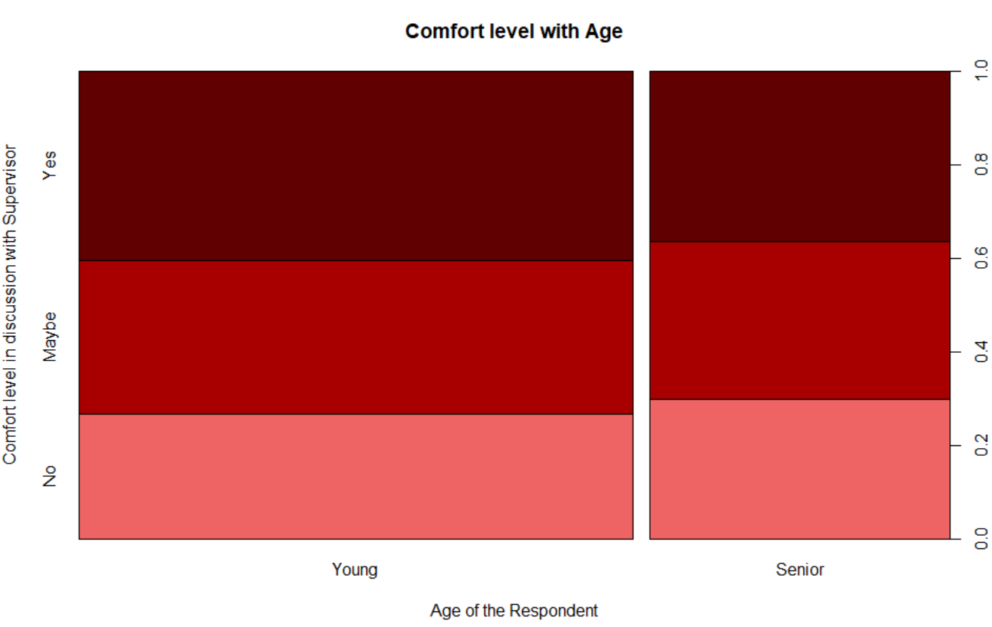
Age Vs Comfort (1 of 2)
Research Question: Is younger generation more likely to discuss mood and anxiety disorders with the employer as compared to the older generation?
Visualization
Interpretation Summary
No significant difference in ‘young’ and ‘senior’ groups in discussing mental health issues with their employers
Slightly higher number of senior population feel less comfortable
Slightly higher number of young population who feel more comfortable

Slide 10
Age Vs Comfort (2 of 2)
NULL HYPOTHESIS (H₀ ): Age Group has no effect on the comfort level of employees in discussing mental health issues with the employers.
Multinomial Logistic Regression Results:
Predictor Variable: age
Response Variable: discuss.supervisor Reference Level: ‘No’
Coefficients
P - values
Responses | (Intercept) | Age Senior
Maybe | 0.2058517 | -0.08180029
Yes | 0.4187112 | -0.21461616
Responses | (Intercept) | Age Senior
Maybe | 0.0431863675 | 0.6257655
Yes | 0.0000169379 | 0.1882085
Interpretation Summary
For a senior employee, the chances of being comfortable sharing their mental health issues with employers decreases by log odds of 0.214 times. Since, the p-value is large we can fail to reject the null hypothesis

Slide 11
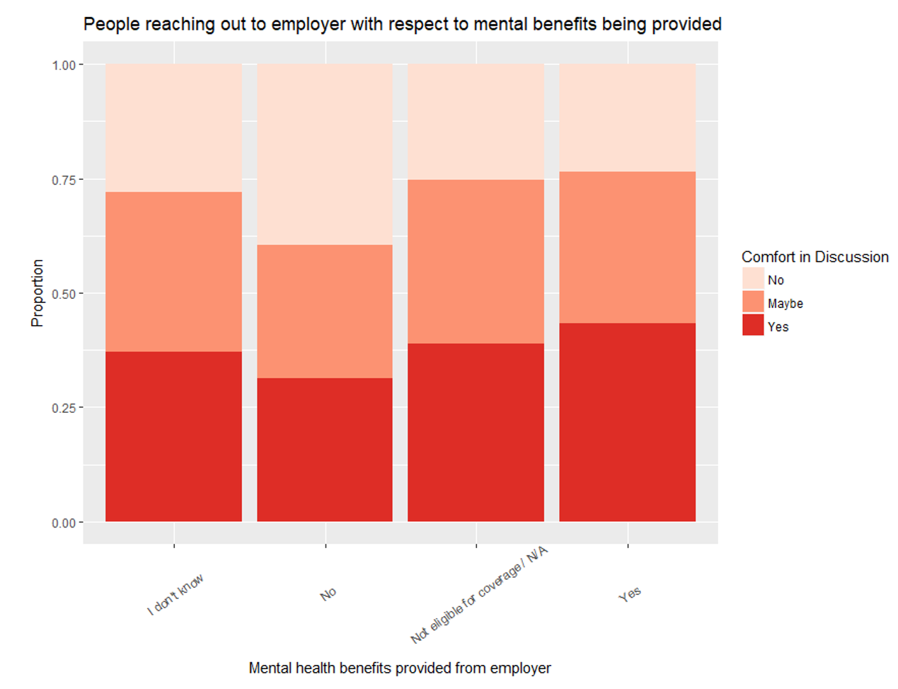
Mental Health Benefits Vs Comfort (1 of 2)
Research Question: What percentage of employees reach out for help to the employer, given that the employer is providing benefits to those who are suffering from mental illness?
Visualization
Interpretation Summary
More respondents comfortable discussing mental health issues when benefits provided
Higher number of people unsure about discussing mental health conditions when benefits not provided

Slide 12
Mental Health Benefits Vs Comfort(2 of 2)
NULL HYPOTHESIS (H0 ): Mental health benefits has no correlation on the comfort level of employees in discussing mental health issues with the employers.
Multinomial Logistic Regression Results:
Predictor Variable: mental.health.coverage, mental.health.options
Response Variable: discuss.supervisor Reference Level: ‘No’
Coefficients
P - values
Responses | Intercept | M.H.C. Yes | M.H.O. Yes
Maybe | -0.06008401 | 0.6778930 | 0.2460047
Yes | -0.36117709 | 0.8969061 | 0.2371459
Responses | Intercept | M.H.C. Yes | M.H.O. Yes
Maybe | 0.8086687 | 0.0080860392 | 0.1401285
Yes | 0.1581522 | 0.0005432982 | 0.2565406
Interpretation Summary
The log odds of employees sharing mental health concerns vs not sharing increases by 0.896 when we move from mental health benefits not provided to provided.
M.H.C. -> Mental Health Coverage; M.H.O. -> Mental Health Options

Slide 13
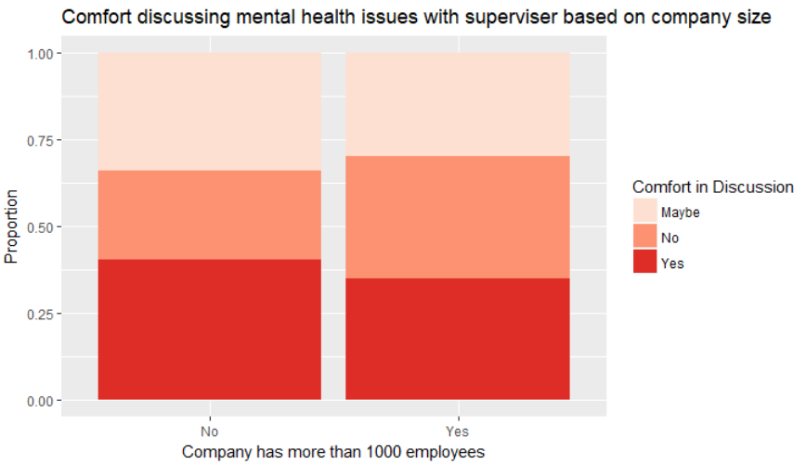
Organization Size Vs Comfort(1 of 2)
Research Question: Are employees in larger companies (>1000 employees) more comfortable in discussing mental health issues with employers, compared to those in smaller companies (<=1000 employees)?
Visualization
Interpretation Summary
Some difference is seen in comfort, based on company size
Slightly smaller proportion of respondents from larger companies who felt comfortable
A larger difference in terms of the number of people who were not comfortable

Slide 14
Organization Size Vs Comfort(2 of 2)
NULL HYPOTHESIS (H0 ): Company size has no correlation with the comfort level of employees in discussing mental health issues with their employers.
Multinomial Logistic Regression Results:
Predictor Variable: organization size
Response Variable: discuss.supervisor Reference Level: ‘No’
Coefficients
P - values
Responses | Intercept | largeYes
Maybe | 0.1272910 | -0.4317561
Yes | 0.2647987 | -0.4453203
Responses | Intercept | largeYes
Maybe | 0.167605496 | 0.02503678
Yes | 0.003065686 | 0.01622374
Interpretation Summary
The log odds of being comfortable discussing mental health issues with a supervisor decrease by 0.44 times if we move from a smaller company (<=1000 employees) to a larger one (>1000 employees)

Slide 15
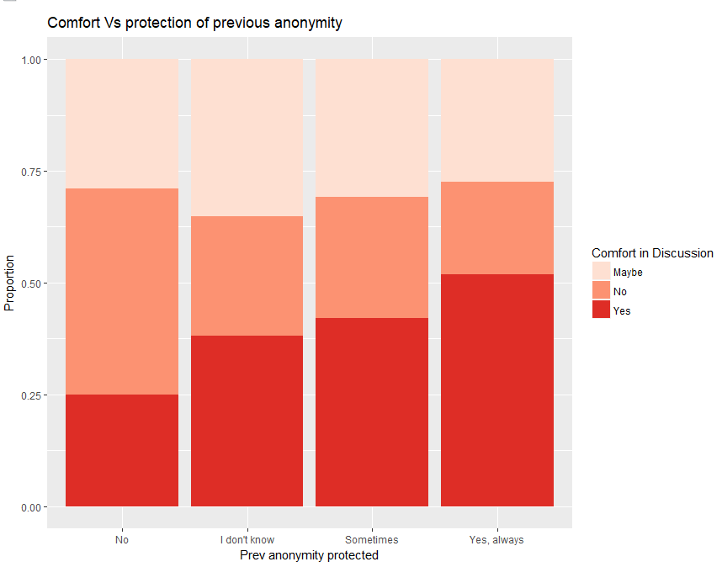
Previous Anonymity Protection Vs Comfort(1 of 2)
Research Question: What percentage of employees reach out for help to the employer, given that the employer is providing benefits to those who are suffering from mental illness?
Visualization
Interpretation Summary
Correlation between previous anonymity protection and employee’s comfort is evident
Large proportion of employees express not being comfortable when anonymity wasn’t protected previously
Similarly, large proportion of employees feel comfortable when anonymity was protected previously

Slide 16
Previous Anonymity Protection Vs Comfort(2 of 2)
NULL HYPOTHESIS (H0 ): Protection of anonymity in previous employment has no correlation on the comfort level of employees in discussing mental health issues with the employers.
Multinomial Logistic Regression Results:
Predictor Variable: prev.anonymity.protected
Response Variable: discuss.supervisor Reference Level: ‘No’
Coefficients
Interpretation Summary
Responses | Intercept | I don’t know | Sometimes | Yes, always
Maybe | -0.4613069 | 0.7433614 | 0.5904953 | 0.7400299
Yes | -0.6097688 | 0.9731592 | 1.0491105 | 1.5260640
For an employee, the chances of being comfortable sharing their mental health issues with employers increase by log odds of 1.526 times when their anonymity was protected previously.
P - values
Responses | Intercept | I don’t know | Sometimes | Yes, always
Maybe | 0.05171004 | 0.003829720 | 0.089600469 | 3.190669e-02
Yes | 0.01412599 | 0.000266949 | 0.002301068 | 4.988074e-06

Slide 17
Multinomial Logistic Regression: Full Model
Model:
multinom(formula=discuss.supervisor ~ age + organization.size.large + prev.anonymity.protected + mental.health.coverage + mental.health.options, data = mdat4)
Coefficients
Confusion Matrix
Responses | Age Senior | Org Size Large | Anonymity protected Yes | Mental health coverage Yes | Mental health options Yes
Maybe | -0.02889494 | -0.5870206 | 0.6253331 | 0.7319060 | 0.06206543
Yes | -0.19754389 | -0.5511425 | 1.3336427 | 0.9466876 | 0.54424254
Prediction | No | Maybe | Yes
No | 20 | 8 | 9
Maybe | 20 | 28 | 19
Yes | 16 | 31 | 51
P - values
Responses | Age Senior | Org Size Large | Anonymity protected Yes | Mental health coverage Yes | Mental health options Yes
Maybe | 0.8689589 | 0.004136788 | 0.0763080434 | 0.0055060816 | 0.80500894
Yes | 0.2514821 | 0.005614765 | 0.0001060427 | 0.0004167449 | 0.02466187
Overall Statistics
Accuracy: 49.01%
95% CI: (41.93%, 56.12%)

Slide 18
Multinomial Logistic Regression: Reduced Model
Model :
multinom (formula = discuss.supervisor ~ organization.size.large + prev.anonymity.protected + mental.health.coverage + mental.health.options, data = mdat4)
Coefficients
Confusion Matrix
Responses | Org Size Large | Anonymity protected Yes | Mental health coverage Yes | Mental health options Yes
Maybe | -0.5920654 | 0.6226737 | 0.7323285 | 0.0605879
Yes | -0.5916918 | 1.3112163 | 0.9314683 | 0.5605082
Prediction | No | Maybe | Yes
No | 21 | 8 | 9
Maybe | 20 | 31 | 21
Yes | 15 | 28 | 49
P - values
Responses | Org Size Large | Anonymity protected Yes | Mental health coverage Yes | Mental health options Yes
Maybe | 0.003319573 | 0.0769922969 | 0.0054389989 | 0.80947964
Yes | 0.002525532 | 0.0001332636 | 0.0005040497 | 0.02049898
Overall Statistics
Accuracy: 50%
95% CI: (42.9%, 57.1%)

Slide 19
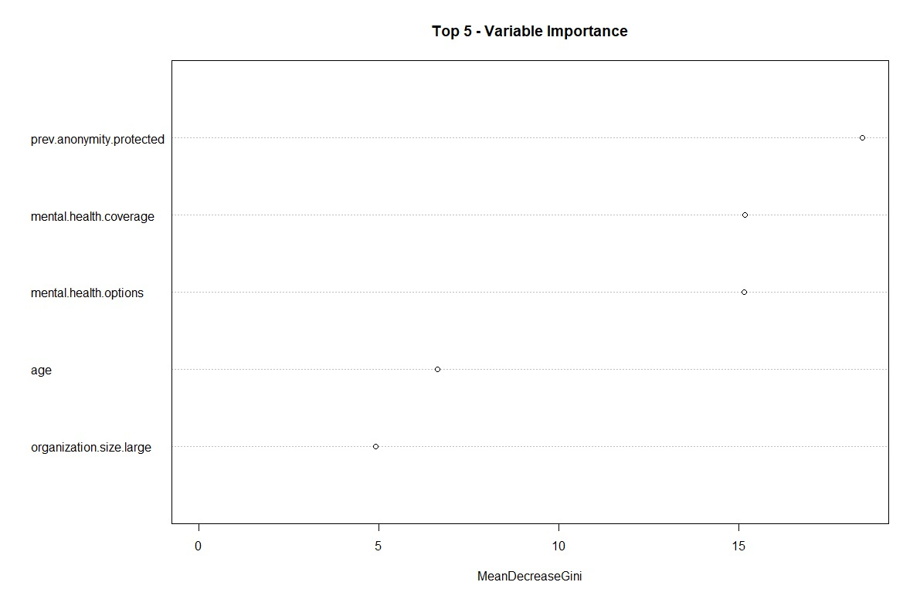
Random Forest: Full Model
Model:
od.forest <- randomForest(discuss.supervisor ~ age + organization.size.large + prev.anonymity.protected + mental.health.coverage + mental.health.options, data=train)
Confusion Matrix
Prediction | Maybe | No | Yes
Maybe | 40 | 25 | 47
No | 18 | 24 | 17
Yes | 43 | 35 | 55
Overall Statistics
Accuracy: 39.80%
95% CI: (34.26, 45.55)

Slide 20
Random Forest: Reduced Model
Model :
mod.forest <- randomForest(discuss.supervisor ~ prev.anonymity.protected + mental.health.coverage + mental.health.options, data=train)
Confusion Matrix
Prediction | Maybe | No | Yes
Maybe | 32 | 21 | 33
No | 15 | 25 | 17
Yes | 54 | 38 | 69
parameters | Class: No | Class: Maybe | Class: Yes
Sensitivity | 0.29762 | 0.3168 | 0.5714
Specificity | 0.85455 | 0.7340 | 0.4973
Overall Statistics
Accuracy: 41.12%
95% CI: (35.53%, 46.88%)

Slide 21
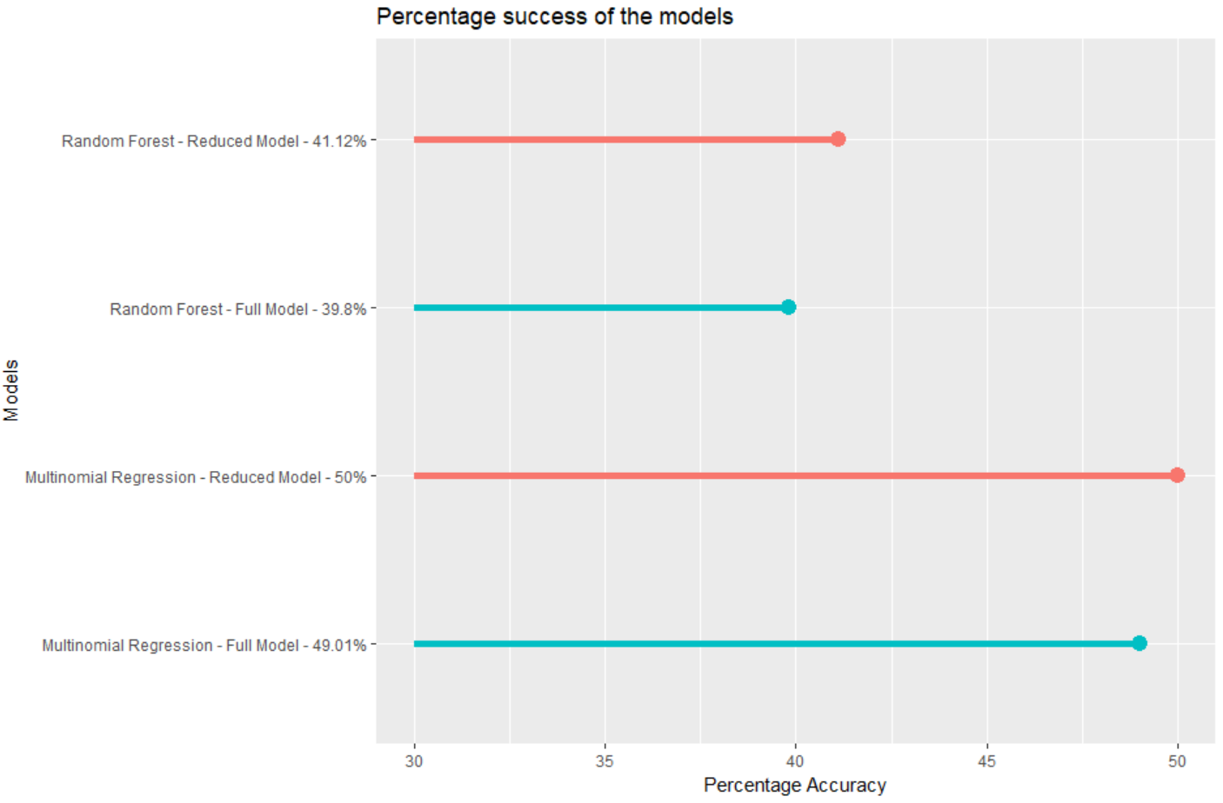
Model Comparison
Reduced Multinomial Regression model had the highest accuracy.
Predictors with the strongest significance include:
Organization size
Anonymity Protection
Mental Health Benefits
Mental Health Options

Slide 22
Recommendations
Based on our analysis and findings, we have come up with following recommendations for tech industry employers and OSMI from data collection point of view:
Developing policies for educating supervisors and coworkers about mental health issues and how to care for employees suffering from these disorders
Increasing awareness among the employees about mental health benefits and coverage provided by the employers
Ensuring protection of anonymity of the employees suffering from mental health disorders to encourage them to come and share such issues in future
Developing age agnostic policies for mental health care and focusing on other parameters such as type of disorders, anonymity, benefits etc.
OSMI to include more questions about how open employees are about discussing their mental conditions and issues

Slide 23
Limitations and Future Scope
Here are some of the limitations and future scope of work in assessing the comfort level of employees in the tech industry:
Sampling bias introduced as respondents were not chosen based on a random sampling approach.
Inferring associations and not causality
Considering people working for organizations in tech industry and can be extended to self-employed
Exploring additional features present in the dataset which concern the demographics
Identifying additional predictive models could be used for better prediction and accuracy

Slide 24
References
[1] Kasbergen, N. (2017). Mental Health in Tech at NationJS 2016. Retrieved from “https://npr.codes/mental-health-in-tech-at-nationjs-2016-9ea6ce99f6f0”
[2] OSMI (n.d.). OSMI Mental Health in Tech Survey 2016: Data on prevalence and attitudes towards mental
health among tech workers. Retrieved from https://www.kaggle.com/osmi/mental-health-in-tech-
2016/feed
[3] Nguyen, J. (2016). Are You More Than Okay: The State of Mental Health in Tech in 2016. Retrieved from “https://modelviewculture.com/pieces/are-you-more-than-okay-the-state-of-mental-health-in-tech-in-2016”
[4] Mental health in the workspace Infographic (2017). Retrieved from “https://elearninginfographics.com/mental-health-in-the-workplace-infographic/”
[5] Workplace stress and mental health in the workplace: infographic (2017). Retrieved from “https://www.thepeoplespace.com/brand/articles/workplace-stress-and-mental-health-workplace-infographic”

